Slide 1
Multi-Effect Guitar Pedal
By: Noah Peña

Slide 2
Introduction
Combine multiple audio effects into one guitar pedal
Ability to change effects
Ability to chain effects
Easy to use

Slide 3
Motivation
Minimize Guitar Pedal Board
Wider variety of effects
Unique sounds

Slide 4
Guitar Pedal
Intel Edison
500 MHz Dual Core Intel Atom x86 Processor
1 GB of RAM
4 GB of Flash Memory
Integrated Bluetooth 4.0 + BLE and Wi-Fi
Runs Poky Linux

Slide 5
Bluetooth Classic vs Bluetooth Low Energy (BLE)
Bluetooth Classic maintains a constant connection while BLE sends it short bursts
Bluetooth Classic uses profiles while BLE uses Services and Characteristics

Slide 6
Software Utilized
Android
Java
Sound Exchange (SoX)
Node.js
Bleno
Process_Child

Slide 7
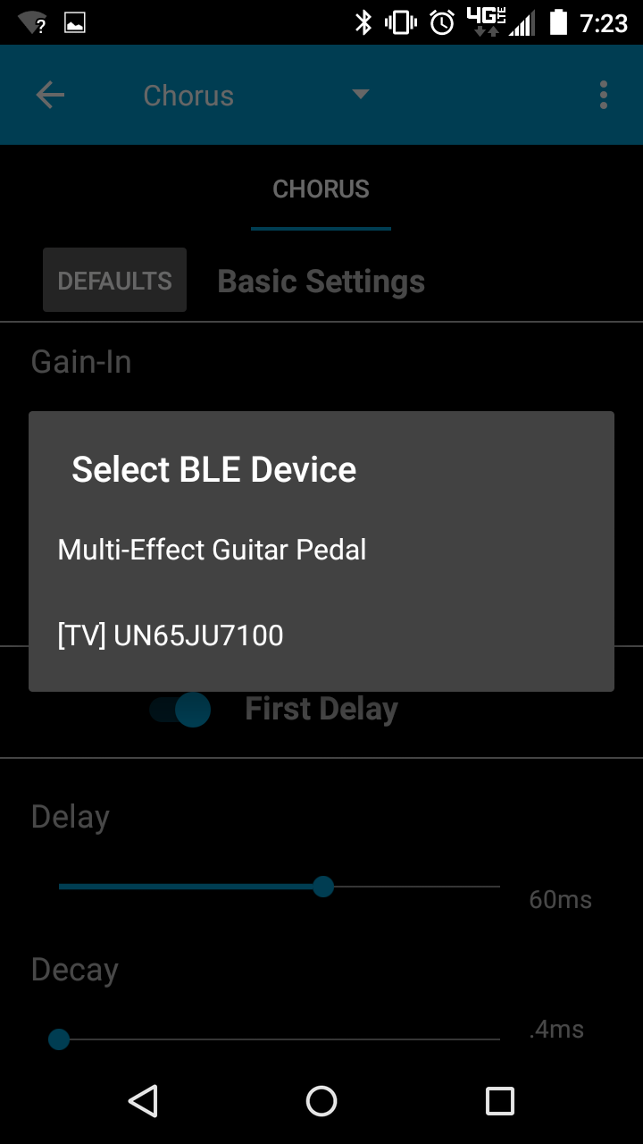
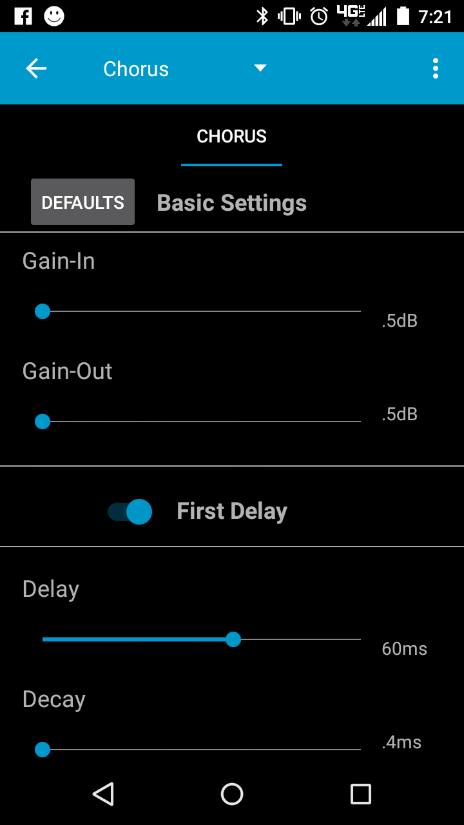
Select BLE Device

Slide 8
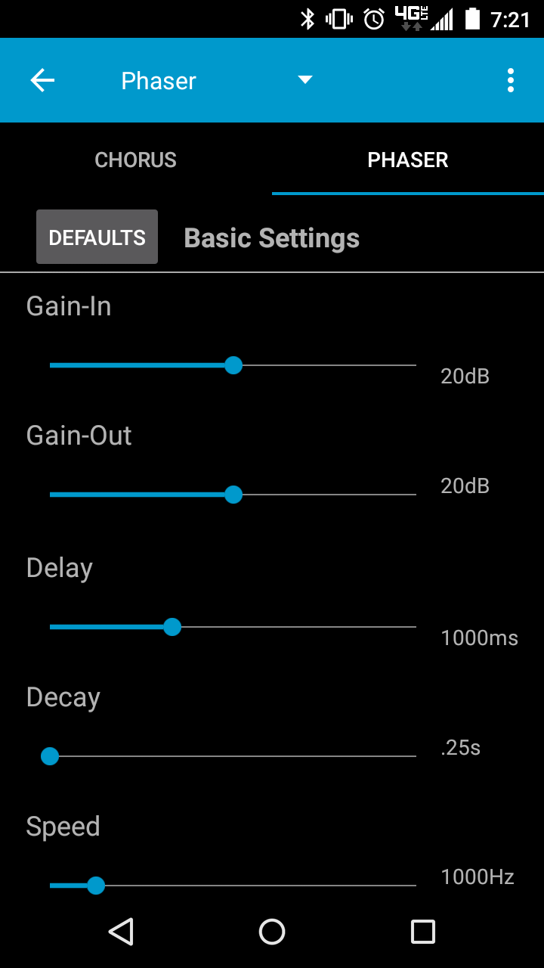
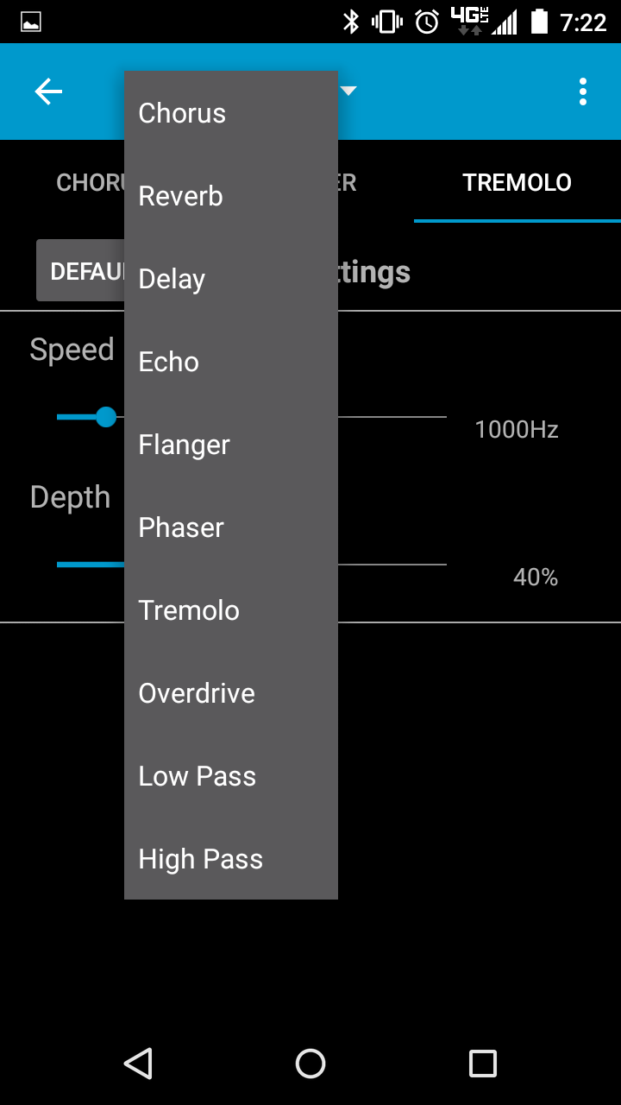
Add Tabs for Effects Chaining

Slide 9
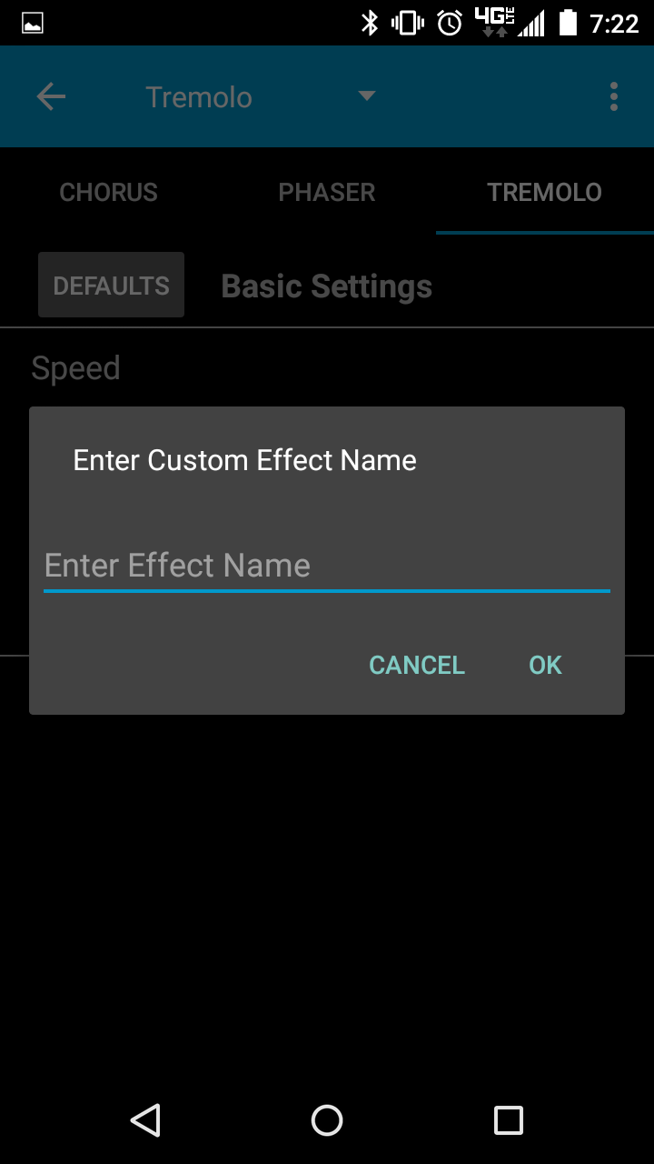
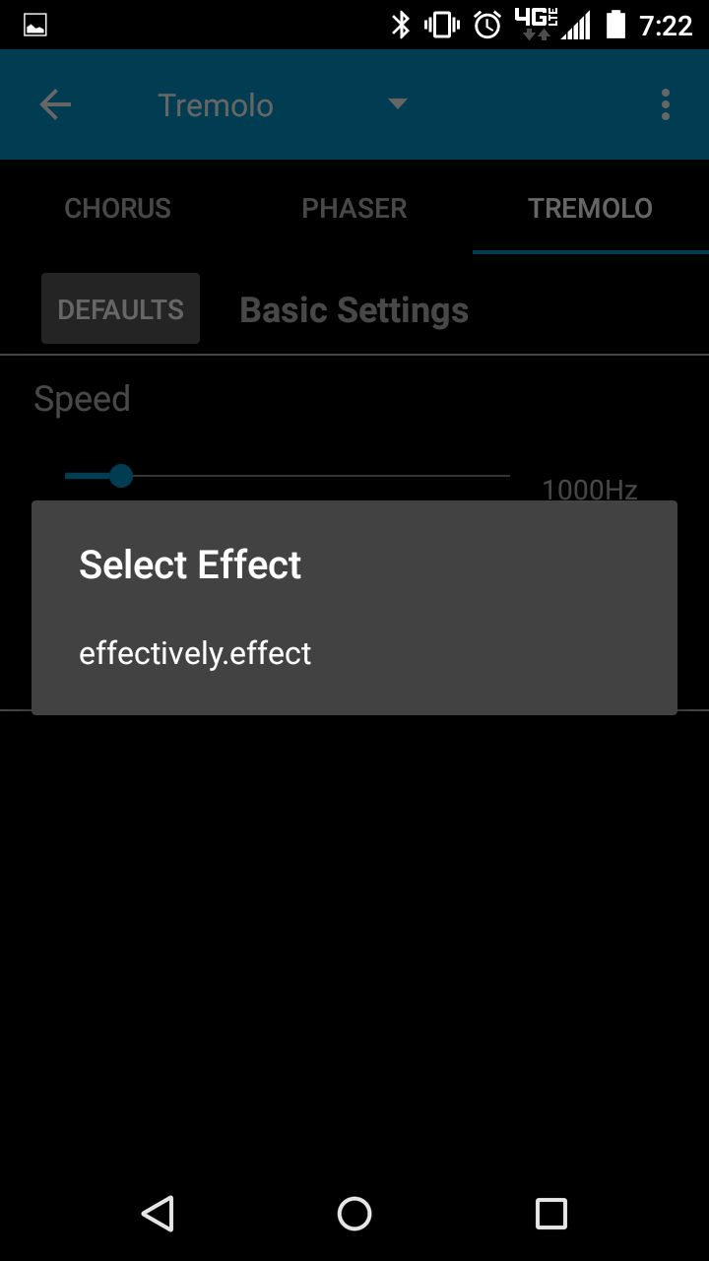
Save User Created Effects

Slide 10
Use Cases
Useful for musicians that want to travel light
Good for beginning guitar players to experiment with effects

Slide 11
Future Work
Implement iOS Application
Ditch the Intel Edison
Support for set lists

Slide 12
Questions?

